Slide 1
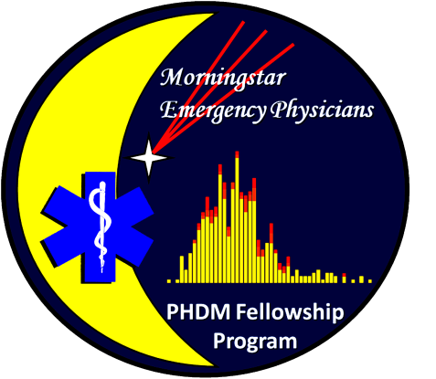
Managing Austere Environments
David E. Hogan DO MPH FACEP
Adjunct Professor
Oklahoma State University
ISWMC Emergency Medicine Residency Program
Oklahoma City, Oklahoma

Slide 2
Educational Objectives
Define the Imposed Austere Environment
List and discuss several common causes of AEs in Oklahoma
Outline the major problems associated with providing health care in an imposed AE
Outline and discuss several solutions to potential problems associated with AEs

Slide 3
The Setting
Emergency Health Care is heavily based on technology
Society is dependent on technology for almost all routine functions
The infrastructure maintaining that technology is tenuous and subject to failure
What has the general experience been with AEs in Oklahoma?
What are some of the problems and solutions for imposed austere conditions?
Notes:
Emergency health care, and indeed all modern health care in the United States is heavily based on technology. This ranges from laboratory studies to complex imaging and most therapy is based on expensive and complex medications or procedures. Much of the technology and process involved in providing modern health care is also associated with improving “therapeutic experience” and patient satisfaction through elements of care that are not really required to achieve the same therapeutic results in the long run.
Western society in general has become almost totally dependent on technology for most activities of daily life. The majority of people living in the United States today have never known life without television, computers, ATMs or even the internet in many cases. The majority of health care providers in practice today have never had to practice in an environment without access to such high technology. Most medical records, tracking and billing processes are totally dependent on computerized technology without which, the provision of such daily health care comes to a rapid stop.
Yet all this infrastructure and its technology is tenuous and highly subject to failure from multiple causes. At the same time, loss of such infrastructure in no way atteunates the need for ongoing health care – particularly Emergency Health Care (EHC).
This presentation will attempt to summarize the problems and solutions for the public health and clinical practice environment when austere conditions are imposed on these agencies and facilities.

Slide 4
The Austere Environment
Provision of care in restricted environments
  Military Medicine
  Wilderness/Expedition Medicine
  3rd World care
  Disaster care
  Rural medicine
Provision of care under imposed Austerity
  Loss of power
  Loss of infrastructure
  Overwhelming the health care system
Notes:
We have some familiarity with providing health care in austere environments. This includes such endeavors as combat environments in Military Medicine, Wilderness and expedition medicine, care in 3rd world environments, disaster care in infrastructure damaged regions and even in some rural areas of developed nations. In addition to these experiences, AEs may be imposed on health care systems due to various mass casualty-disaster related events. These events may impose and AE through loss of electrical power, loss of infrastructure or an overwhelming of the health care system for various periods of time.

Slide 5
Defining the Austere Environment
Imposed austere environments (AE) represent a large scale Public Health Emergency
There are multiple causes of imposed AEs
AEs represent the conditions associated with loss of the ability of Health Care Agencies and Facilities to provide health care at the established standard of care levels existing before the AE causing event(s).
A central authority must exist to coordinate
Notes:
Although large scale mass casualty – disaster events impact the clinical management of individual patients, they also impact the overall health and well-being of the community population. As such, these events represent large-scale Public Health Emergencies. The overall authority for coordination and management of resources during such events lies with the agencies tasked with the protection of the health of the public.
There are multiple causes of AEs and multiple levels of severity. Each cause will present organizations with different challenges and solutions although there will be commonalities with each cause. Such commonalities present at least some advantage to planners in that some general solutions will be applicable to almost all the causative events presenting.
In general, AEs represent the conditions associated with loss of the ability of Health Care Agencies and Facilities to provide health care at the established standard of care levels existing before the AE causing event(s). These events will, to varying degrees, require reallocation, restriction and alternative management of health care procedures and resources in AEs and the resource restricted environment they represent.
To be effective in maximizing the overall health and well being of the community as well as the maximal preservation of life and limb during such events, authority for making such changes in the health care processes must lie with some central agency of the governing authorities. In general, this is usually – and appropriately – within the Departments of Public Health.

Slide 6

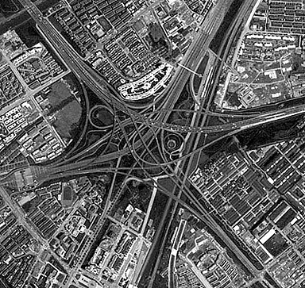

Casualty Accumulation Sources
Casualty arrival
  From the AE causing event
  From SNFs, Rehabilitation Facilities, Assisted living, etc
  From the general population (the lights are on phenomenon)
  Local HCPs
  Hospital Evacuations
  Regional Evacuations – “Referrals”
Notes:
Casualties and other associated persons will accumulate at health care facilities during imposed AEs. In addition to the usual arrival of patients, with the imposition of an AE, casualties will likely arrive to hospitals from other sources. Hospitals have, at least to some extent emergency power generators and therefore represeent an “Island of Light” in a general sea of darkness. Casualties are likely to be generated from the AE causing event itself. These will arrive by EMS as well as private vehicles. With the loss of power and infrastructure, it is likely that other facilities such as skilled nursing facilities, rehabilitation units, long term care facilities, and assisted living units will, if able, transport many of their residents to hospitals for evaluation and care. In many settings, members of the general population in the community surrounding the hospital will congregate at the hospital as the only source “stability” within the community. Local health care providers will (if operational at all) often send their patients to the Emergency Department for evaluation, care and treatment. Some hospitals may need to be evacuated for safety reasons, leaving the marginally functional hospitals of the community to accept and care for these patients who cannot be discharged home or out of the region. Finally, it has been noted in the past that hospitals more severely impacted that may be well outside of the community zone, may evacuate patients to marginally functional hospitals still under the stress of AEs. Means of managing these casualty influxes need to be considered and planned for.

Slide 7
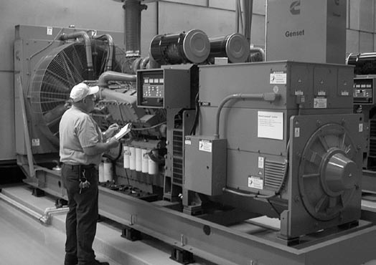
Electrical Power
All Hospitals have a power back-up system
Variable levels of capacity and duration
Provide only limited amounts of diagnostic and support service
Limits the level of therapeutic intervention that can be provided
Notes:
All hospitals are required to have emergency back-up power available. This usually means a power generator located somewhere on the campus of the facility. Hospitals are however quite variable in the capacity and duration of the emergency power provided. All emergency power is limited within facilities to critical areas of the campus. This usually includes some power for the Emergency Department, Intensive Care Units and Operative/OB care areas. It is usually intended to allow for the completion of operative procedures caught by the power outtage and the continuance of limited ICU care and Emergency Health Care. It is not sufficient to fully manage environmental controls or full hospital operations. Even the limited power provided is dependent on the continued function of the generator system which is often limited to 24 hours to 1 week at most. Protocols must be in place to provide for refueling and maintance of these generators – particularly if the duration of the AE is likely to be extended.

Slide 8
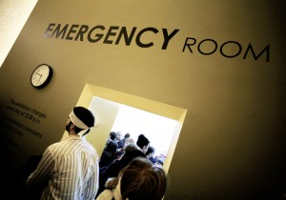
Triage Considerations
The basic purpose is unaltered from “disaster triage” (Greatest Good Concept)
Triage is extended into the monitoring and “inpatient” setting
Dynamic and repetitive process
Triage is an “Inexact” process
Triage should be based on a protocol process
Notes:
During an AE, the medical care environment shifts from daily protocols to disaster related protocols due to a scarcity of medical resource. Disaster Triage is employed to assist in making the decisions as to how that scarce resource is to be metered out in order to do the greatest good for the greatest number of casualties. In addition, the concept of triage also becomes extended into the monitoring and “inpatient” setting when the system becomes overwhelmed or without the nescessary reources to treat casualties at prior levels of care. The triage protocols must be egalitarian, and used to determine not only resource allocation, but prioritization for transport out of the AE should that become possible. Triage is an inexact process subject to the normal human frailties and foibles, however using preexisting guidance and protocols helps in making these decisions.

Slide 9
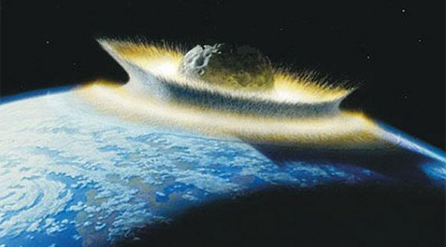
Apocalypse Level Events
Planning is of little use in such an event
Survival is beyond the ability of even large Nation-States and is largely a matter of luck
Notes:
Any general perusal of the current media (History Channel, Discovery Channel, Science Channel, SCiFi Channel etc.) will provide one with the myriad of ways that humanity can be exterminated from the face of the earth. Planning for such an event, although clearly a rigorous and stimulating mental exercise, is likely to produce no viable results. Survival in these setting is beyond the ability of even large Nation-States and is largely a matter of luck. Contemplation of these possible, but improbable events can lead one to a mental state of despair and futility. One should rather plan for the more probable events for which planning will be effective.

Slide 10
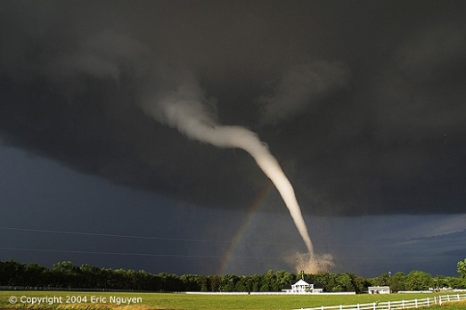
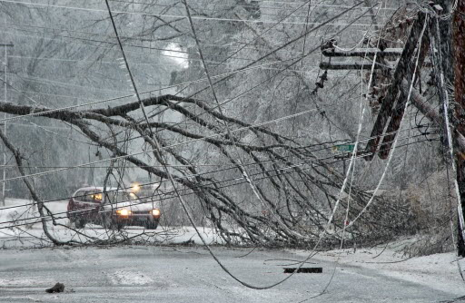
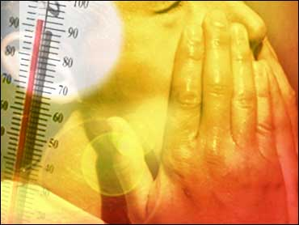
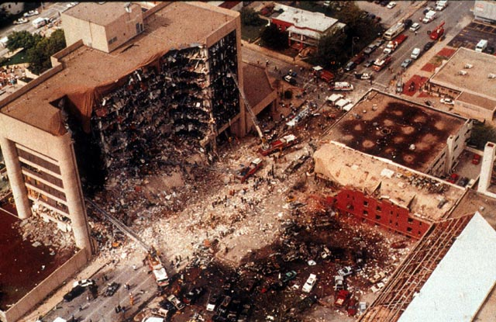
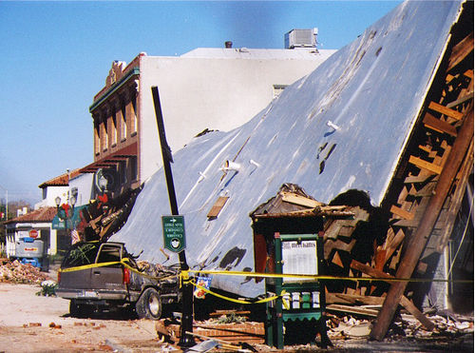
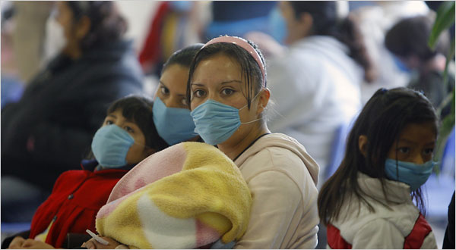
Causes of Austere Environments
Planning based on risk assessment for probable events is much more effective
In this context, planning decreases the overall adverse impact of such events
Notes:
One of the basic tennents of disaster medicine is that one should plan based on valid assumptions. Part of this is to plan around events that are likely to happen within ones community – determined through a process of risk assessment. A brief look at our region determines that the most likely causes of AEs include tornadoes, Winter Storms, Heat Emergencies, Wildfires, Terrorism, Earthquakes, Pandemic Disease and others. Other events such as phenomena that disrupt the power grid (X-Class solar flares) or computer failure (cyber attacks) can also variously disrupt infrastructure. Recognition of the risks and the nature of the AE imposed by such events can direct planning efforts. Planning in this context will decrease the overall effect of such AEs on the population impacted and improve overall outcomes.

Slide 11
Major Disaster Declarations
1955-2010 - Oklahoma
FEMA 2011
Notes:
A review of the Major Disaster Declarations from 1955 to 2010 in Oklahoma helps us determine what the likely causes of AE might be in the near future. We find that most of the events are weather related with severe storms and or tornadoes accounting for most of the events. Note that in 85% of these storm-tornado events, flooding was also a factor. Winter Storms and Ice Storms account for the next largest proportion of events with Wildfires and isolated Floods coming next. The terrorist bombing in Oklahoma City accounted for the final event for a total of 66 Major Disaster Declarations over the period discussed. This gives us a pattern of risk to start investigating the nature of the AE generated by these events.

Slide 12
Tornado Generated AE
Rapid Geographic related surge
Power disruption
Travel restrictions
Transfer problems
Communication problems
Disposition problems
staffing
147 Casualties arrived in a 2 hour period
At a 10 bed ED geographically close to the
Tornado Path.
May BM, et al. Impact of a Tornado on a Community Hospital. JAOA 2002;102(4):225-228
Notes:
Although tornadoes are relatively common in Oklahoma (and high intensity tornadoes more common than in most places in the United States) an AE imposed by a tornado may perhaps best be demonstrated by looking at how it impacted a small community hospital in a Metro area. In this case, a small hospital with a 10 bed Emergency Department was heavily impacted by 147 casualties within 2 hour period as it was located geographically close to the tornado strike path. The facility suffered power disruption and relied on it’s back-up power for at least some of the time it cared for casualties. The facility was cut off from usual routes of travel by the tornado debris path and was therefore unable to transport some critical patients needing evacuation by usual ground vehicles. The facility relied heavily on air-medical transportation elements to evacuate several serious head injury and critical pediatric casualties to other facilities.

Slide 13
Winter Storm AE
Major AE Issues
  Power Failures
  Dangerous travel
  Staffing shortages
  Facility damage
  Disposition problems leading to overcrowding
2010 Winter Storm Injuries
n = 1,065
OSDH 2010

Slide 14
Floods and AE
Impact depends on rate of rise and duration and extent of inundation
Evacuation of facilities if flooded
Alternate treatment sites
Travel routes altered
Referral and disposition problems
Staffing problems
Resupply problems
524 cases over 28 days
CDC. Flood Related Mortality – Missouri, 1993. MMWR 1993;42:797-798

Slide 15
Wild Fires and AE
Restricted Travel
Evacuation of Facilities (rapid)
Environmental
  Smoke
  Heat
  Wind
Power disruption
Disrupted referral patterns
n = 277 over 3 days
Shusterman D, et al. Immediate health effects of an urban wildfire. West J Med. 1993;158:133-138.

Slide 16
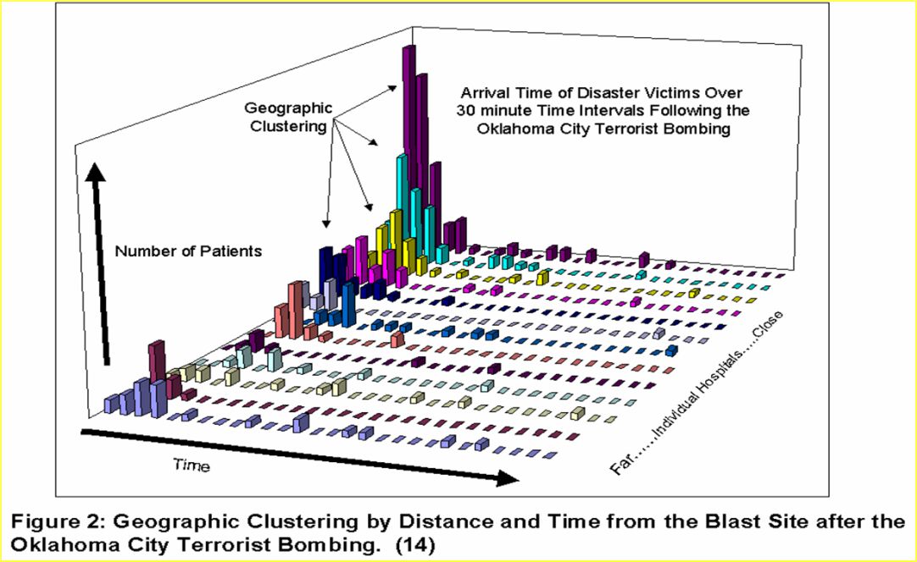
Terrorist Bombing
AE Created by Rapid Casualty Influx
Surge Characteristics
  First Cases 15 minutes
  Peak Rate 220/hr at 60 to 90 minutes
  At 3 hrs 62.5% of all cases had arrived for care
Geographic Effect
  Noted at 1.5 miles
    63% vs 36.4% p = <.0001
Hogan DE, et al. Emergency Department Impact of the Oklahoma City Terrorist Bombing. Ann Emerg Med 1999;34:160-167.
Notes:
Surge Characteristics – Geotemporal distribution of Oklahoma City Bombing Casualties
Examination of the surge from the same event demonstrates the geographical and temporal characteristics of the casualty distribution through the metropolitan area. The X axis depicts the individual hospitals that received casualties with those closest to the bombed site located at the junction of all the axes and those farther away more distant from the junction. The Y axis indicates the number of casualties in a bar graph format that arrived during each individual 30 minuet time period. The Z axis runs to the right of the X axis in this case and demonstrates each 30 minute time period.
The data demonstrate that the first cases started arriving at the closest facilities within 15 minutes of the blast. The peak rate of arrival was 220 cases/hr at the 60 to 90 minute interval. At 3 hours 62.5% of all casualties seen had arrived at the metro Emergency Departments for care. The “geographic effect” or geographic phenomenon (clustering of casualties at the closest facitlties to a focal event disaster) was observed in this case within a radius of 1.5 miles with 63% verses 36.4% of the total casualties arriving at hospitals within that radius p = <0.001.
Hogan DE, et al. Emergency Department Impact of the Oklahoma City Terrorist Bombing. Ann Emerg Med 1999;34:160-167

Slide 17
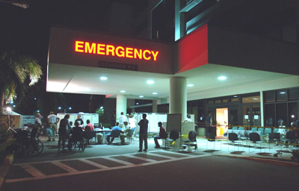
Operational Approaches
Initial Priorities
  Rapid triage
  Rapid stabilization
Secondary Priorities
  Provision of definitive care
  Provision of some level of supportive care
  Monitoring/Repeat triage Protocols
Operational Goals
  Resolution of causes of the AE
  Transport of casualties out of the AE
Notes:
As the event imposes and AE, assessments are carried out to determine the severity and extent of the infrastructure disruption. Responses and recommendations will be based on this assessment.
The initial priorities of health care facilities are not particularly different from normal operations. Rapid triage and categorization of injury or illness severity of arriving casualties is carried out. Efforts will then be carried out to stabilize casualties consistent with the available resources.
In the next phase, casualties that can be provided with definitive care for their conditions (in the context of available resources) if this can be done. Some of these casualties may then be placed in monitoring or recovery areas till they can be discharged. Note that in some cases, the casualty may not have a “home” to be discharged to if this has been destroyed in the AE causing event. Many patients will need to be provided with some form of supportive care depending on their illness or injury and whreather or not they have been definitivly treated. Such supportive care will require some manner of basic monitoring protocols be available as the AE may remove the usual technological modes of such monitoring. Incorporated with this should be a form of triage/transport prioritization even if resources or transport are not currently available.
The overarching goals of the institution should be – as much as possible – resolution of the causers of the AE, or removal of the patients from the AE.

Slide 18
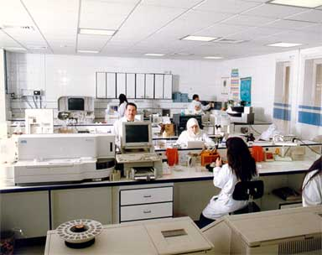
Loss of Diagnostic Laboratory
In the imposed AE, many functions of the diagnostic laboratory may be lost – at least for a period of time

Slide 19
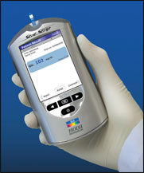
Point of Care Testing
Accurate, portable, rechargable
  Glucose, HgA1C, Electrolytes, CRP, creatatine, ABG, amylase, cardiac markers, PT, INR, Drug screens, BNP, iCa, Mg, Lactate, Osmolality, others.

Slide 20

Bedside Dipstick Testing
Standard older technology
  Glucose, ketones, blood, protein, nitrite, pH, urobilinogen, bilirubin, leucocyte esterase, specific gravity.

Slide 21
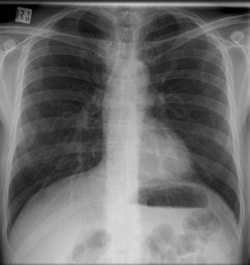
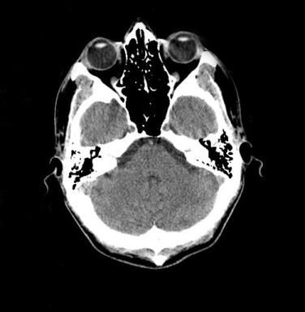
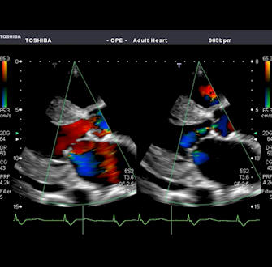
Diagnostic Modalities
Limited X-Ray
Limited CT/MRI
Formal US
Nuclear Medicine Studies

Slide 22
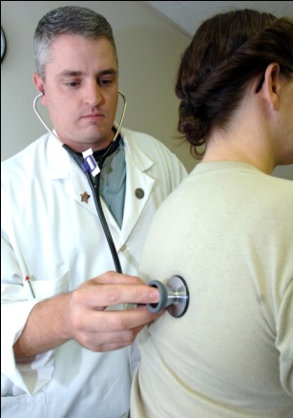
Physical Assessment
Although physical exam skills are still taught in Western Medical Schools, they are less used and less relied upon in daily practice than in the past
These skills will need to be relied on during an AE event

Slide 23
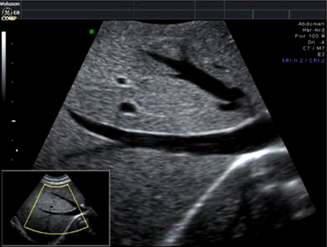
Use of Bedside Ultrasound
Has been a critical utility in many AEs
  FAST
  Pneumothorax
  Cardiac studies
  Fracture detection
  Foreign body
  Abdominal exams
  Line placement
  Expanding utility

Slide 24
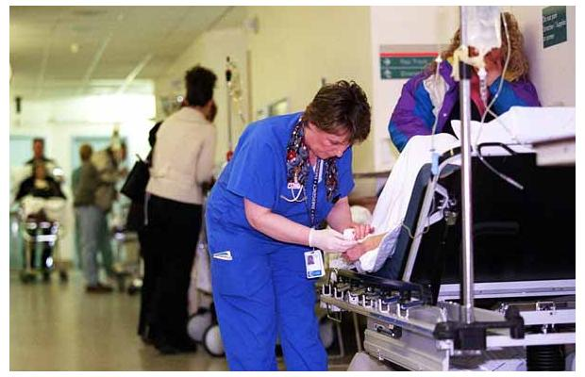
Monitoring Protocols
Protocols must be developed to allow for monitoring of casualties who are being held, treated, or recovered in the facility impacted by the imposed AE

Slide 25
Monitoring Protocols
Airway
  Patent, maintained, obstructed
Breathing
  Ventilation (rate/depth)
  Breath sounds
  Chest excursion
  Cyanosis
Circulation
  Pulse rate
  Blood pressure
  On-going bleeding
Mental Status
  Glasgow score
  AVPU
Intravenous Access
  Patent or infiltrated
Dressings
  quality/quantity of drainage
Splints
  Distal neruovascular function
Waste
  Urine/fecal output
Comfort level
  Evaluate need for analgesia
DeLorenzo RA, Porter RS. Tactical Emergency Care: Military and Operational out of Hospital Medicine. Prentice-Hall 1999

Slide 26
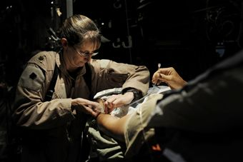
Therapeutic Protocols
Some definitive procedures may be available
Simple temporizing procedures may be used
Alternative procedures may be used
Use of available alternative Rx
Allocation protocols

Slide 27
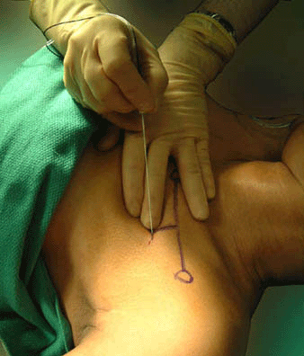
Regional Anesthesia
Less resource intensive than general
Useful for MANY operative procedures
Safe and effective in AE conditions
Missair A, et al. Surgery Under Extreme Conditions in the Aftermath of the 2010 Haiti Earthquake: the Importance of Regional Anesthesia. PHDM 2010;25(6):487-493.
Notes:
Many reports in the medical literature document the benefit and effectiveness of using regional anesthesia in AEs such as combat and disaster environments. A recent publication about the Hatian experience demonstrated the utility of this approach in an AE totally stripped of medical infrastructure. This experience suggests that when local emergency medical resources are completely destroyed or seriously disabled, a surgical team staffed and equipped to provide regional nerve block anesthesia and acute pain management can be dispatched rapidly to serve as a bridge to more advanced field surgical and intensive care, which takes longer to deploy and set up.

Slide 28
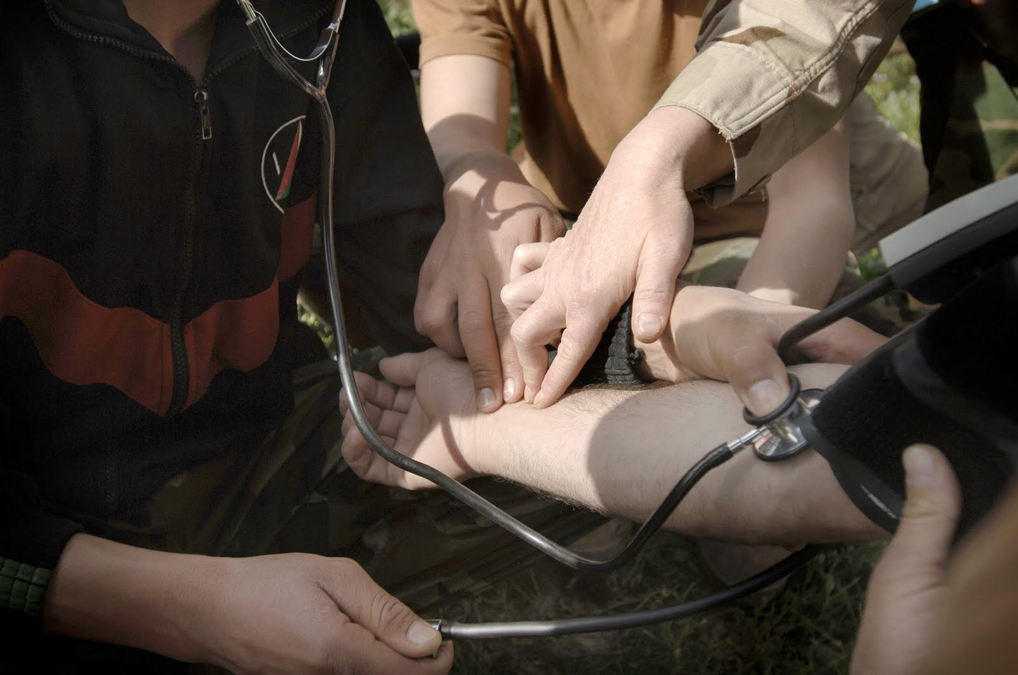
Alternate Treatments
Numerous alternate treatments have been studied in AE and found effective and useful
  Non-operative Tx of penetrating injuries
  Alternate airway methods
  Alternate fluid repletion methods

Slide 29
Transportation Protocols
Part of the General Approach to AE management – removing casualties from the AE
Protocols must be in place to prioritize casualties for transport
Part of the monitoring/triage routine even if transportation is not currently available

Slide 30
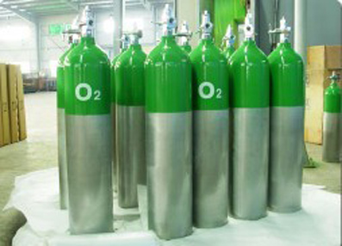
Oxygen/Medical Gasses
Restrict O2 use to documented hypoxia
Use of O2 conserving systems
Reuse of some delivery devices

Slide 31

Medications
Use of alternate Rx (stockpiled)
Gravity drips for infusions
Alternate routes (IM, SQ, PO, IV)
Use of adjunctive Rx (NSAIDs, Antihistamines)
Palliative care

Slide 32
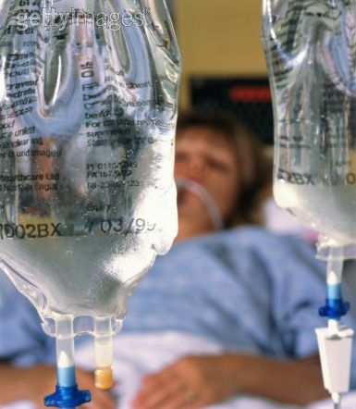
Fluids/Hemodynamic Support
Use of stockpiled or less expensive agents
Gravity drips
Limit invasive monitoring (use clinical monitoring parameters)
Reuse of some catheters (protocols for cleaning)

Slide 33
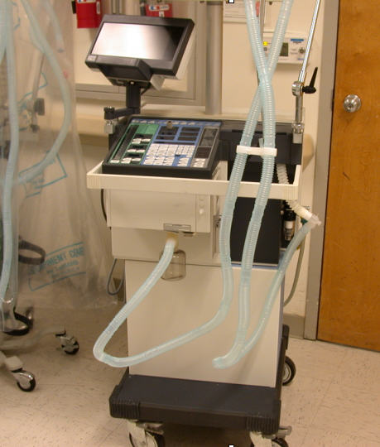
Mechanical Ventilation
Use of alternative ventilation devices
Reduce or eliminate elective procedures
Adjust intubation threshold
Reuse of ventilator circuits
Ventilator Triage Protocols

Slide 34
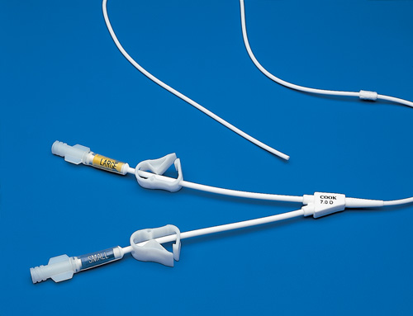
Nutrition
Family assistance
Ancillary staff re-tasking
Limit choices
Tube feedings over TPN
Reuse of some feeding equipment

Slide 35
Staffing
Protocols for outside personnel
Protocols for use of local, state, regional and federal personnel
Protocols for non-professional personnel in specific roles
Use of JITT for some personnel
Extended supervision protocols
Re-tasking of some administrative personnel
Reduction of administrative demands

Slide 36
Summary
Imposed AEs present numerous challenges to the provision of the health care needs of a population
Leadership, guidance, and protocols must be in place for the potential AE causing events
Planning should be based on risk assessment and valid assumptions
Planning and creative actions will decrease the adverse impact of and AE on the community

Slide 37

THANK YOU
The universe grants no species the right to survive. However, the practice of disaster medicine, in the true tradition of medicine, may suggest that humanity has a reason to survive.

